Slide 1

FP6. Enhancing kinodynamic RRT using CBF-based steering Autonomous and Mobile Robotics 2020-2021
Giunta Gaetano Nicotra Emanuele Paggetti Andrea
Prof.: Giuseppe Oriolo
Sup.: Paolo Ferrari

Slide 2
Introduction
Motion Planning Problem
Goal: Algorithms comparison for the motion planning of autonomous mobile robots, subject to non-holonomic constraints
Studied Algorithms:
RRT: Rapidly-exploring Random Tree is the most used among the probabilistic algorithms. Its standard version requires the Collision-Checking (CC) step to make sure that the resulting path is collision-free
RRT + CBF: modified version of the algorithm allows to avoid the CC step by using the Control Barrier functions in the steering mechanism

Slide 3
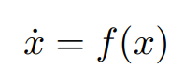
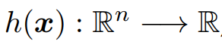
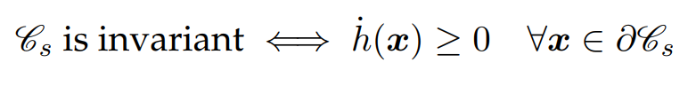
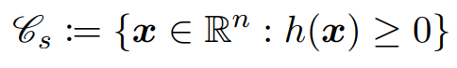
Background on CBF
Safety definition and invariance
Problems:
1. How to define safety and a safety set?
2. How to maintain the robot inside the safety set?
Solutions:
Safety = Minimum clearance from obstacles → A safety set exists and it can be defined
Ensure the invariance of the safety set
From ideas to formulas:
Nagumo’s Theorem
→

Slide 4
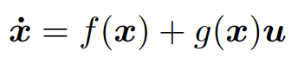
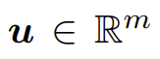
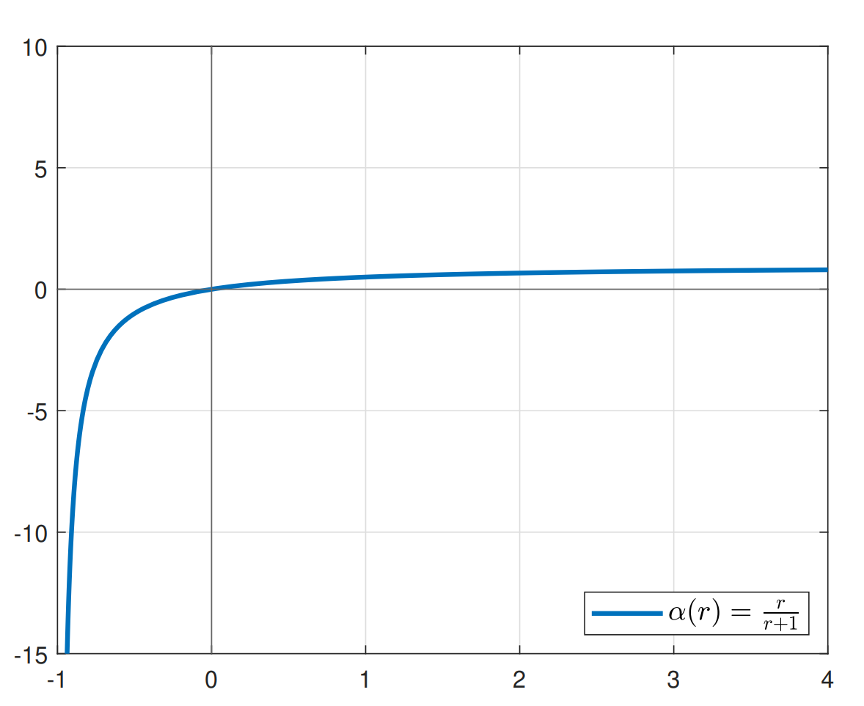
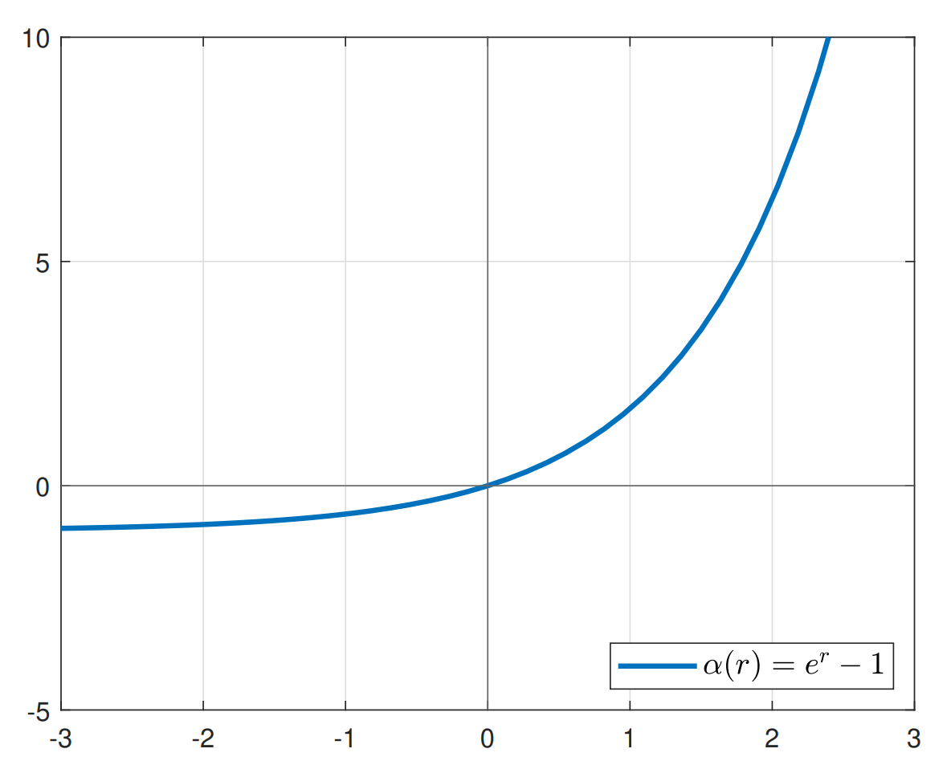
Background on CBF
Class-K functions introduction
Extension to the controlled dynamical system:
Class-K functions introduction:

Slide 5
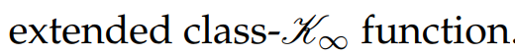
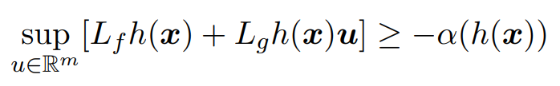
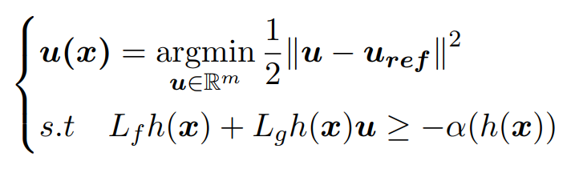
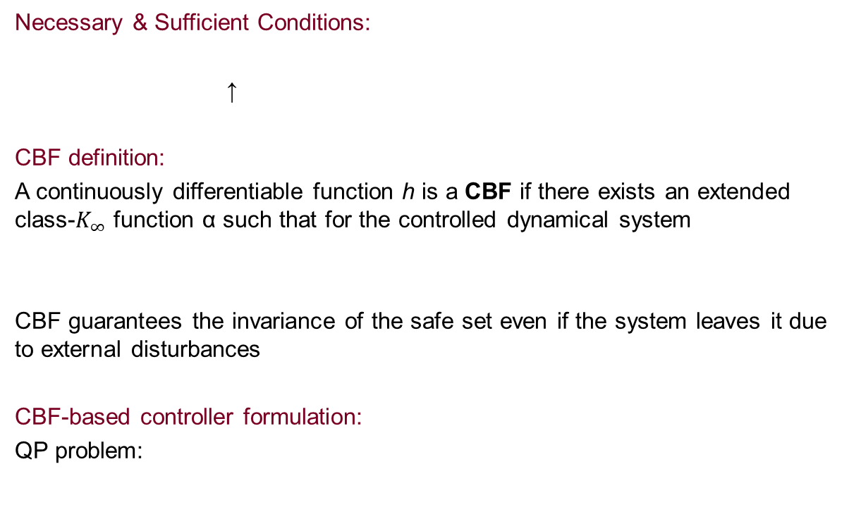
Background on CBF
New conditions and CBF introduction
Necessary & Sufficient Conditions:
↑
CBF definition:
A continuously differentiable function h is a CBF if there exists an extended class-$K_{∞}$ function α such that for the controlled dynamical system
CBF guarantees the invariance of the safe set even if the system leaves it due to external disturbances
CBF-based controller formulation:
QP problem:

Slide 6
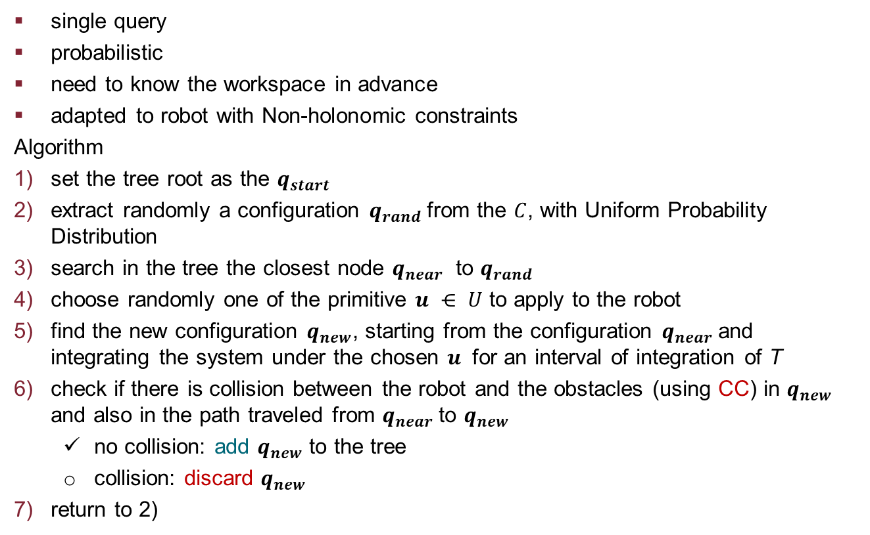
Motion planning algorithms
RRT
single query
probabilistic
need to know the workspace in advance
adapted to robot with Non-holonomic constraints
Algorithm
set the tree root as the $q_{start}$
extract randomly a configuration $q_{rand}$from the $C$, with Uniform Probability Distribution
search in the tree the closest node $q_{near}$ to $q_{rand}$
choose randomly one of the primitive $u ⋲ U$ to apply to the robot
find the new configuration $q_{new}$, starting from the configuration $q_{near}$and integrating the system under the chosen $u$ for an interval of integration of T
check if there is collision between the robot and the obstacles (using CC) in $q_{new}$ and also in the path traveled from $q_{near}$to $q_{new}$
no collision: add $q_{new}$ to the tree
collision: discard $q_{new}$
return to 2)

Slide 7
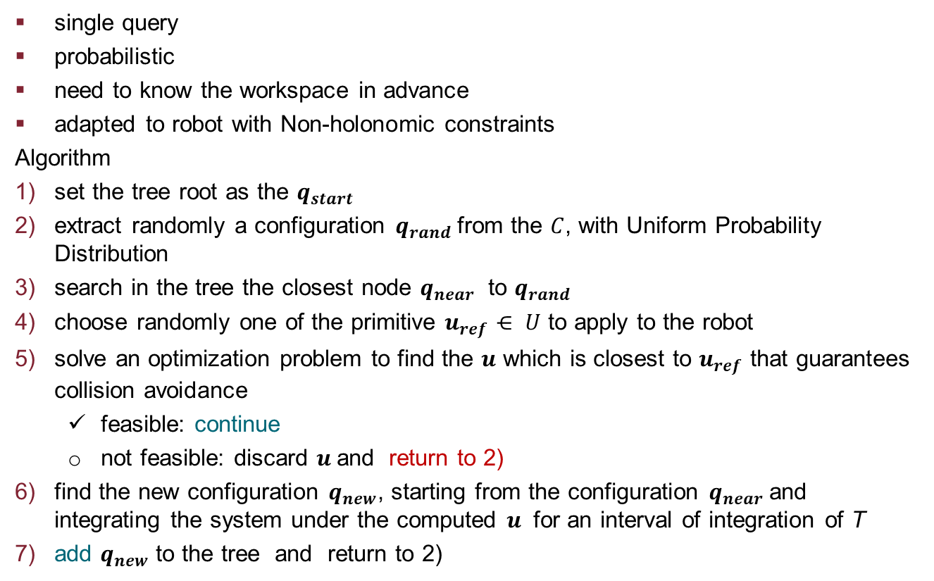
Motion planning algorithms
RRT with CBF
single query
probabilistic
need to know the workspace in advance
adapted to robot with Non-holonomic constraints
Algorithm
set the tree root as the $q_{start}$
extract randomly a configuration $q_{rand}$from the $C$, with Uniform Probability Distribution
search in the tree the closest node $q_{near}$ to $q_{rand}$
choose randomly one of the primitive $u_{ref}⋲ U$ to apply to the robot
solve an optimization problem to find the $u$ which is closest to $u_{ref}$ that guarantees collision avoidance
feasible: continue
not feasible: discard $u$and return to 2)
find the new configuration $q_{new}$, starting from the configuration $q_{near}$and integrating the system under the computed $u$ for an interval of integration of T
add $q_{new}$ to the tree and return to 2)

Slide 8
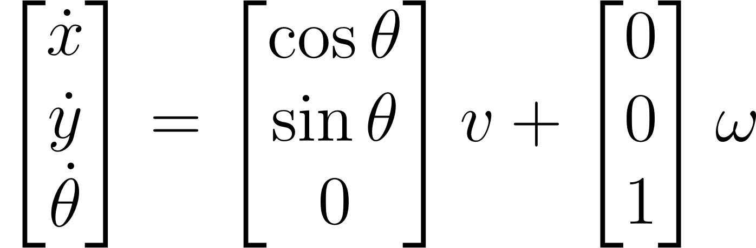
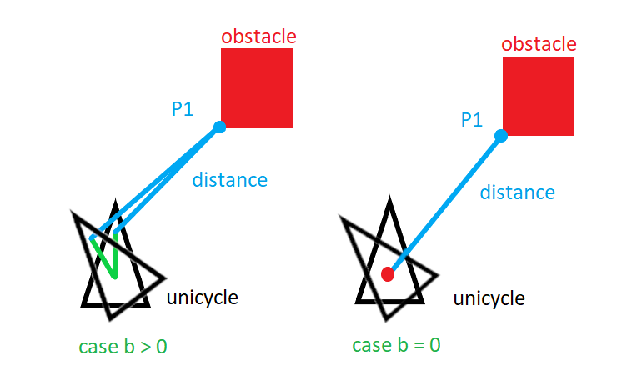
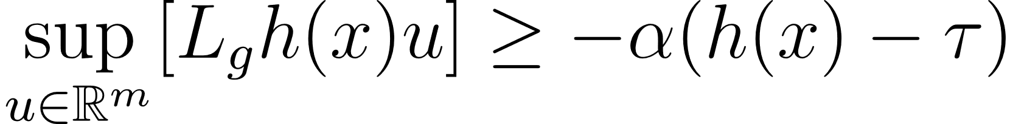


Optimization Problem (qpOases)
Considering unicycle Safe Set
with
Where $h$ is the distance from the closest obstacle
no dependency on ω
add an offset of lenght $b$ along sagittal axis

Slide 9
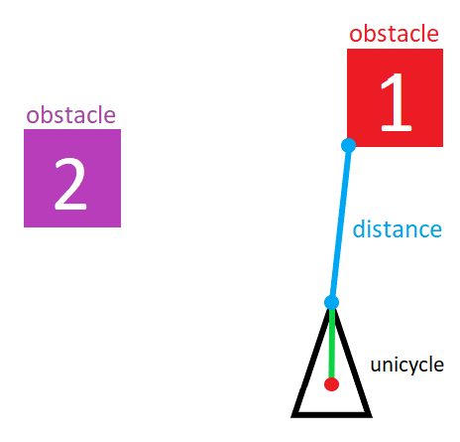
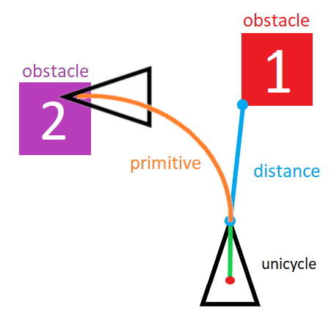
RRT with CBF
Assumption 1
Once choosen the primitives, the integration time interval T is small enough, to not let the following problem occur. (max. traveled space in one T )
starting position final position
T

Slide 10
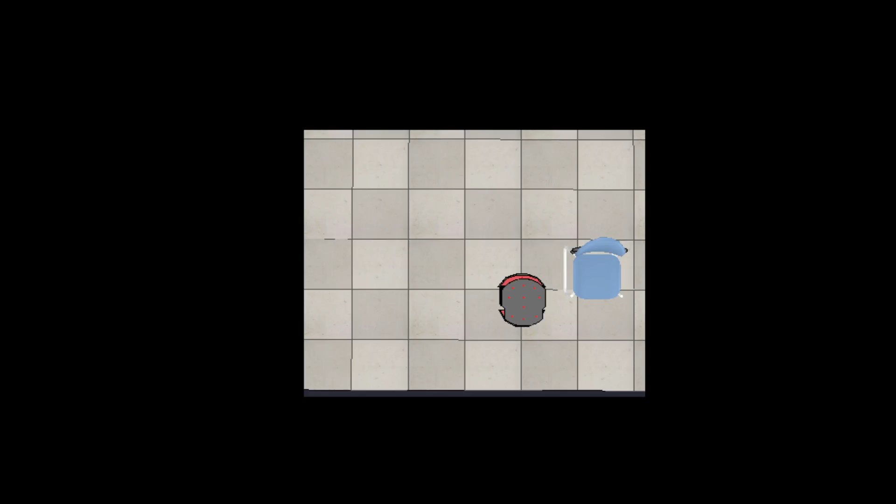
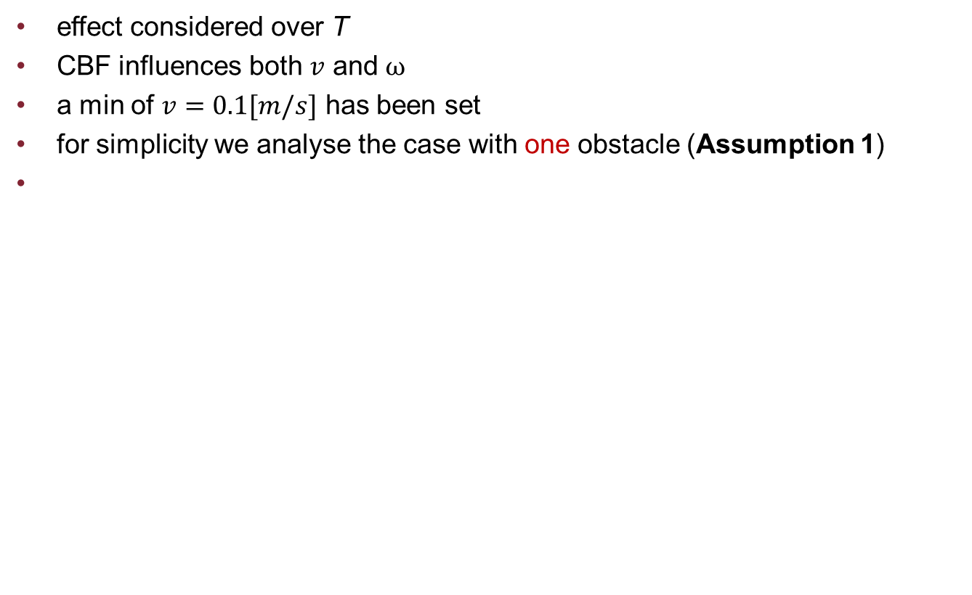
Effect of CBF on primitives
effect considered over T
CBF influences both $v$ and $ω$
a min of $v=0.1[m/s]$ has been set
for simplicity we analyse the case with one obstacle (Assumption 1)
Primitives unmodified Primitives modified by CBF

Slide 11
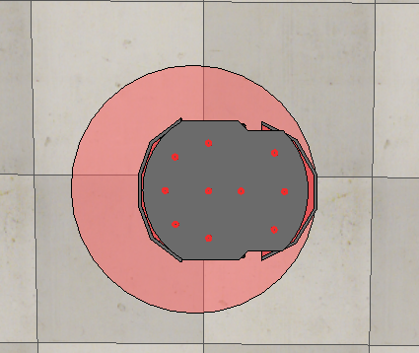
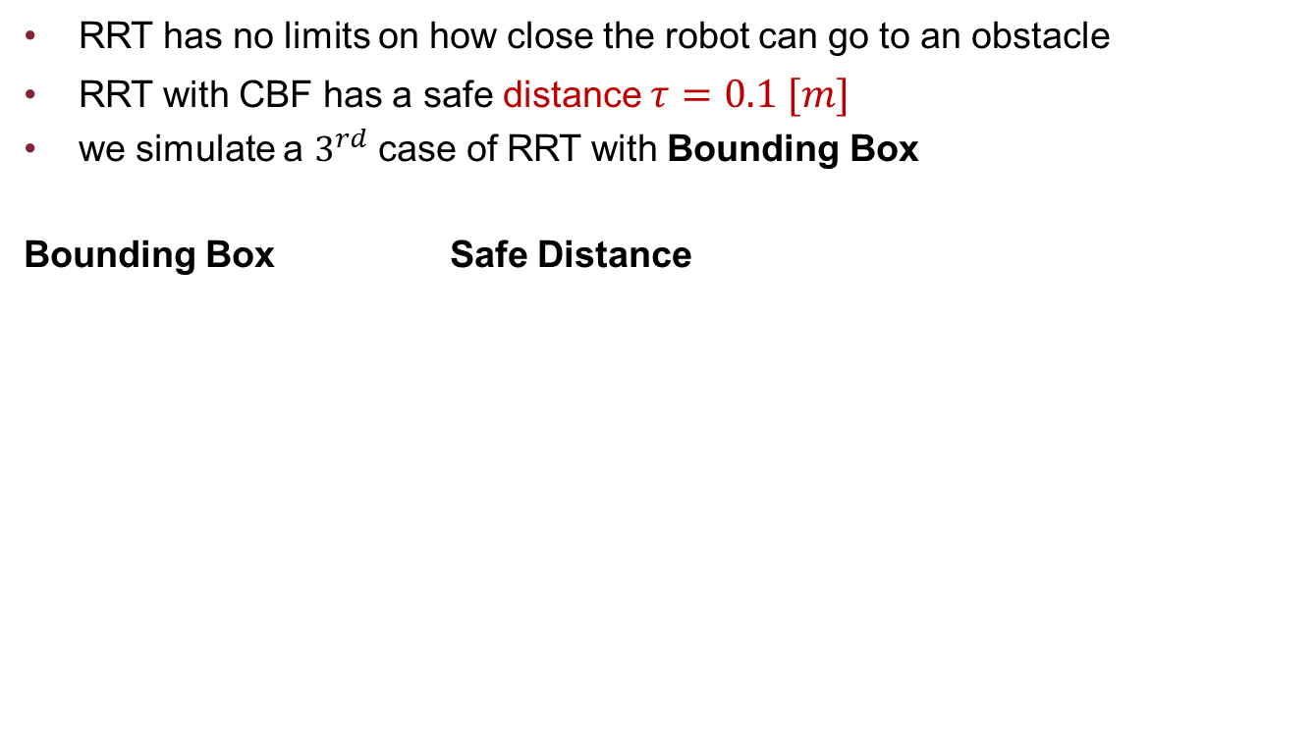
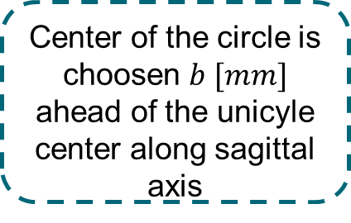
Fair Comparison
RRT with Bounding Box
RRT has no limits on how close the robot can go to an obstacle
RRT with CBF has a safe distance $τ=0.1 [m]$
we simulate a $3^{rd}$ case of RRT with Bounding Box
Bounding Box Safe Distance
Safe distance of 0.1 [m]
Center of the circle is choosen $b [mm]$ ahead of the unicyle center along sagittal axis

Slide 12
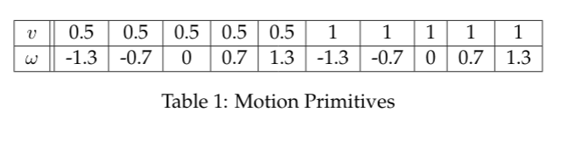
Setting
general
workspace [5mx5m]
goal region radius: 0.1[m]
random choice of primitives
time step: 0.5[s]
maximum number of iterations: 30000
RRT
collision checking active
RRT+CBF
α=2
minimun velocity module: 0.1[m/s]
safe distance: unicycle radius +0.1[m]
RRT+BB
BB radius: 0.7[m]

Slide 13
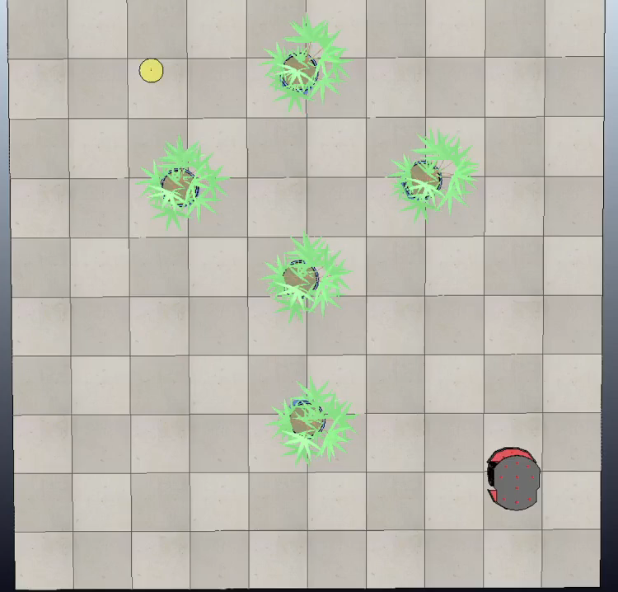
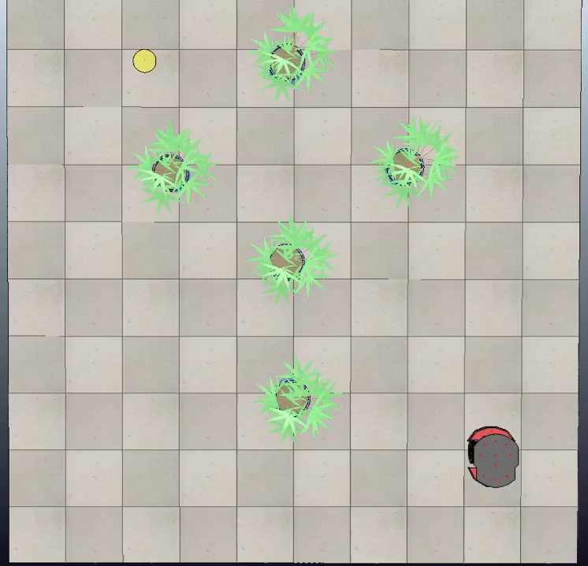
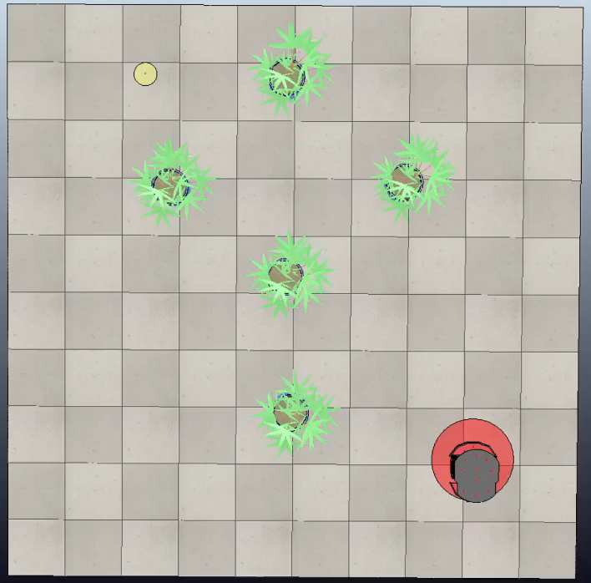
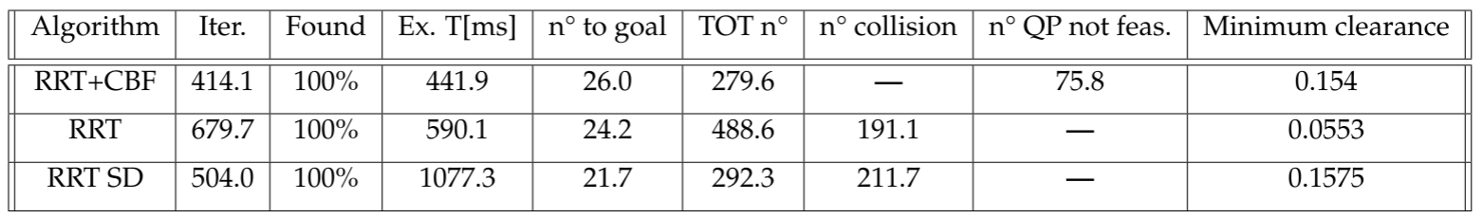
Simulation 1
RRT
RRT+CBF
RRT+BB

Slide 14
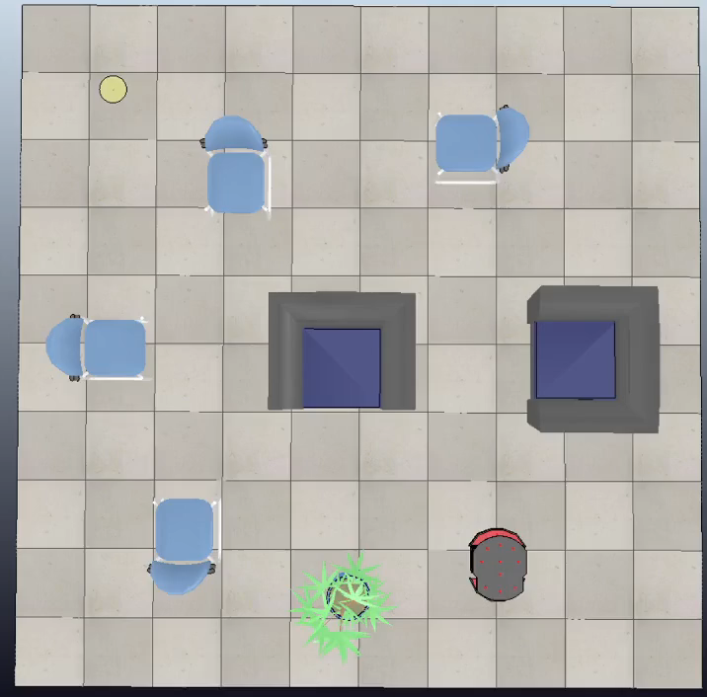
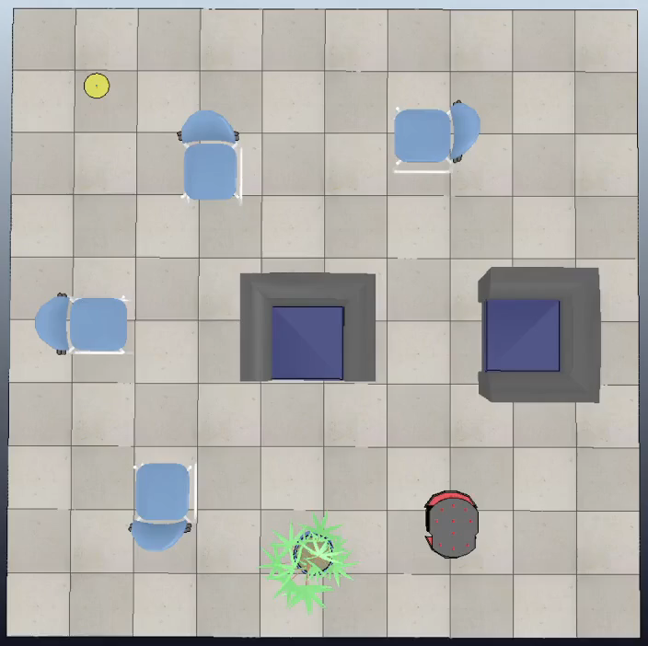
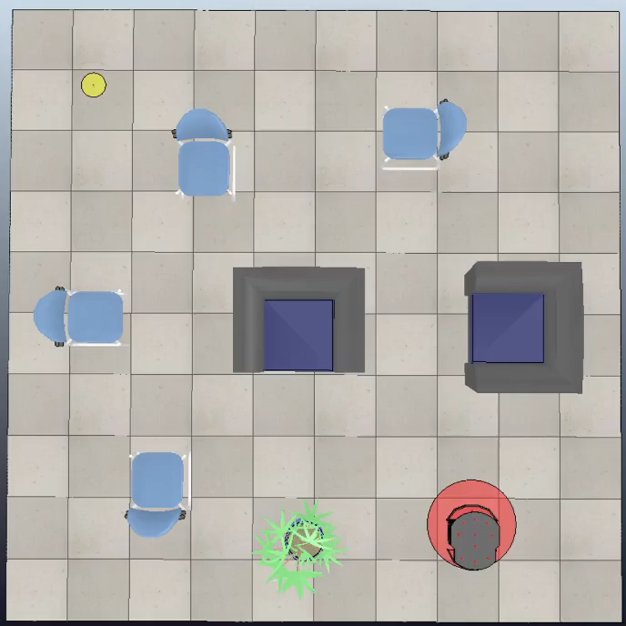
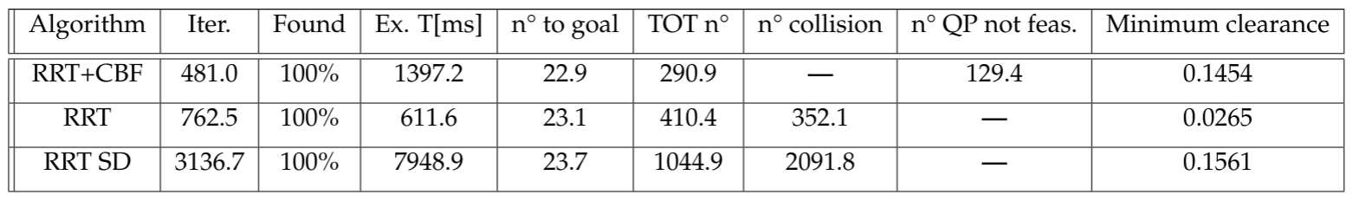
Simulation 2
RRT
RRT+CBF
RRT+BB

Slide 15
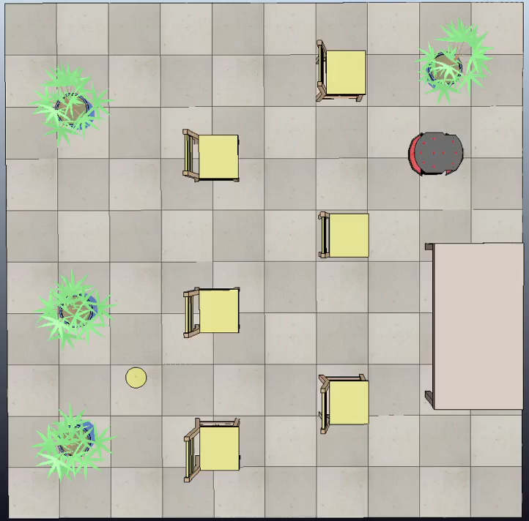
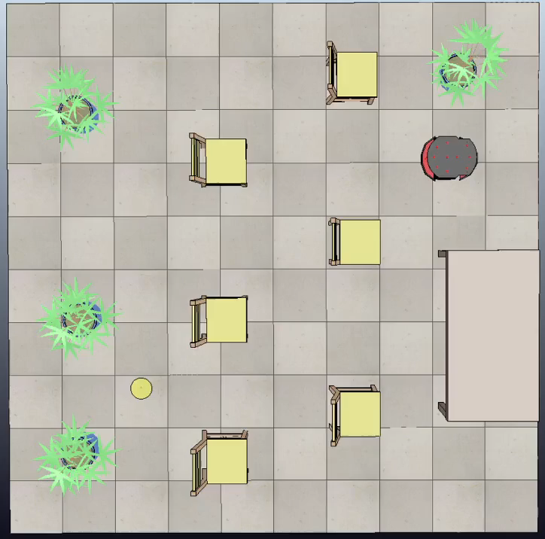
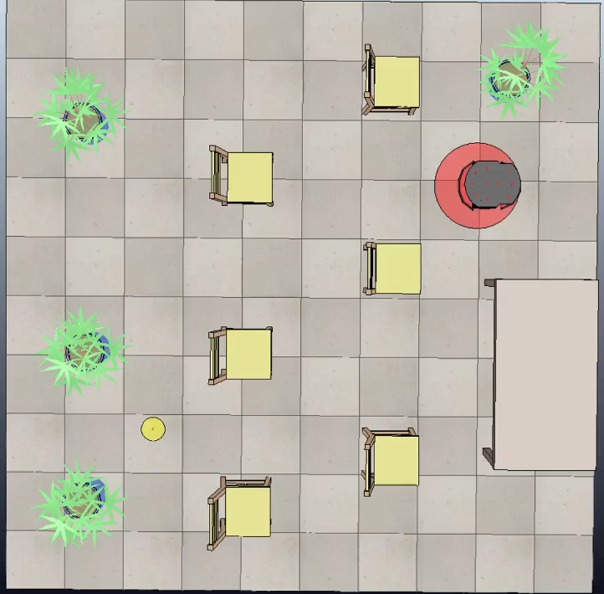
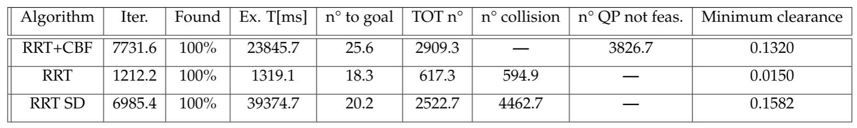
Simulation 3
RRT
RRT+CBF
RRT+BB

Slide 16
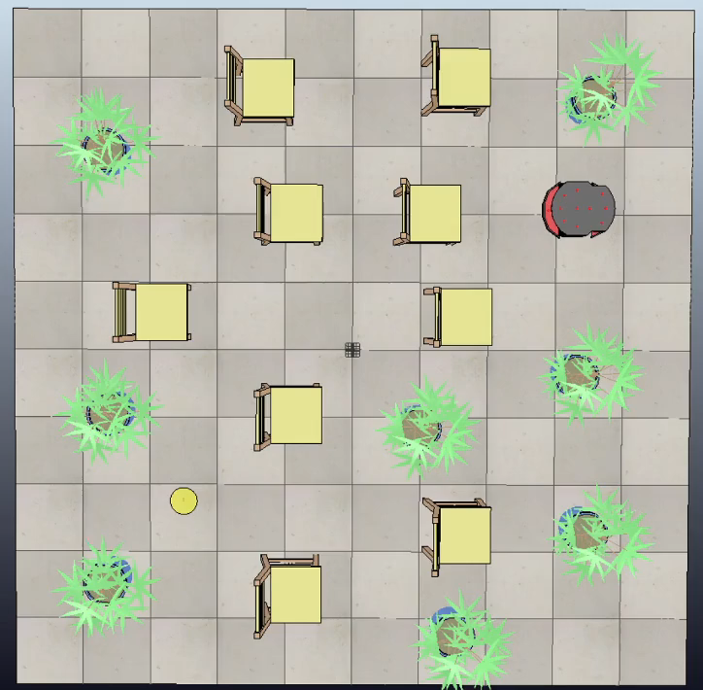
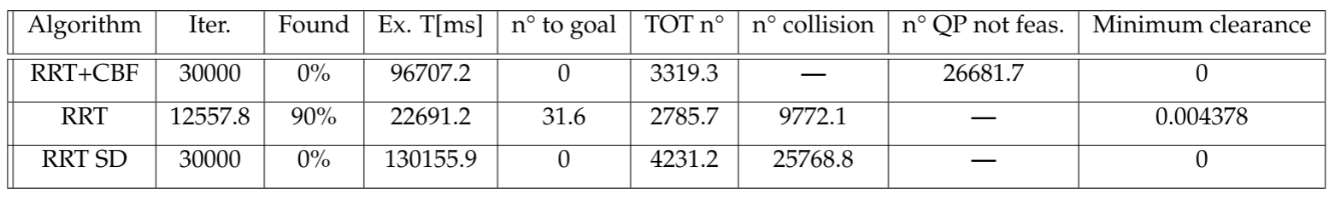
Simulation 4
RRT

Slide 17
Conclusions
main advantage of RRT+CBF is safety; it generates safe paths achieving minimum clearance
narrow passages and crowded environments are critical for the RRT+CBF however it performs better than RRT with bounding box in terms of time
RRT+CBF achieves more freedom in terms of motion primitives without need of strategies as the adaptive stepsize
Future works
extension to dynamical environment

